Slide 1
I’m a PHP Developer, Why Should I Care About Microsoft?

Slide 2
A Microsoft primer for PHP devs
(or…Microsoft and PHP – a love story)

Slide 3


Who Am I?
Peter Laudati
Developer Evangelist – NJ/NY/CT
Microsoft Corporation
peterlau@microsoft.com
Borg Collective ID: X914BZ01

Slide 4
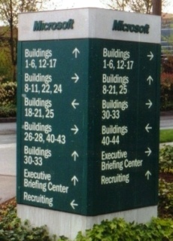
1998 Started working at Microsoft
Notes:
In 1998, I came to work for Microsoft out in Redmond, Wa. It’s a big place. Lots of buildings. They all look the same. It’s easy to get lost. But very beautiful. Lots of fun to work there.
But being a Jersey Shore beach guy, I have to admit, all of those clouds out there in Seattle weren’t for me….

Slide 5
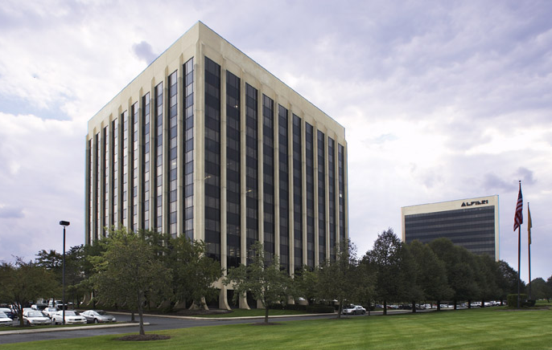
1998 Started working at Microsoft
MetroPark, NJ
Notes:
…so, I moved back home and decided to work for Microsoft in Jersey. That’s the Microsoft office in Jersey. Actually, that WAS the office building in 1998. It’s moved across the street to a different building, but I don’t have a pretty picture of that to share. It’s in an office park known as MetroPark, which is spread across two towns, Edison and Iselin. But Iselin isn’t really a town, it’s a part of Woodbridge, so it gets really confusing to describe where it is. So I just use the “official” Jersey location vocabulary by saying, “It’s at Exit 131!” (on the Garden State Parkway).
(If you’re not from New Jersey, our state joke is to ask someone “What exit?” when you want to know where they live.)

Slide 6
1998 Started working at Microsoft
Edison & Iselin, NJ
Notes:
…so, I moved back home and decided to work for Microsoft right here in Jersey. That’s the Microsoft office in Jersey. Actually, that WAS the office building in 1998. It’s moved across the street to a different building, but I don’t have a pretty picture of that to share. It’s in an office park known as MetroPark, which is spread across two towns, Edison and Iselin. But Iselin isn’t really a town, it’s a part of Woodbridge, so it gets really confusing to describe where it is. So I just use the “official” Jersey location vocabulary by saying, “It’s at Exit 131!” (on the Garden State Parkway).
(If you’re not from New Jersey, our state joke is to ask someone “What exit?” when you want to know where they live.)

Slide 7
1998 Started working at Microsoft
Edison & Woodbridge, NJ
Notes:
…so, I moved back home and decided to work for Microsoft right here in Jersey. That’s the Microsoft office in Jersey. Actually, that WAS the office building in 1998. It’s moved across the street to a different building, but I don’t have a pretty picture of that to share. It’s in an office park known as MetroPark, which is spread across two towns, Edison and Iselin. But Iselin isn’t really a town, it’s a part of Woodbridge, so it gets really confusing to describe where it is. So I just use the “official” Jersey location vocabulary by saying, “It’s at Exit 131!” (on the Garden State Parkway).
(If you’re not from New Jersey, our state joke is to ask someone “What exit?” when you want to know where they live.)

Slide 8
1998 Started working at Microsoft
Exit 131, NJ
Notes:
…so, I moved back home and decided to work for Microsoft right here in Jersey. That’s the Microsoft office in Jersey. Actually, that WAS the office building in 1998. It’s moved across the street to a different building, but I don’t have a pretty picture of that to share. It’s in an office park known as MetroPark, which is spread across two towns, Edison and Iselin. But Iselin isn’t really a town, it’s a part of Woodbridge, so it gets really confusing to describe where it is. So I just use the “official” Jersey location vocabulary by saying, “It’s at Exit 131!” (on the Garden State Parkway).
(If you’re not from New Jersey, our state joke is to ask someone “What exit?” when you want to know where they live.)

Slide 9
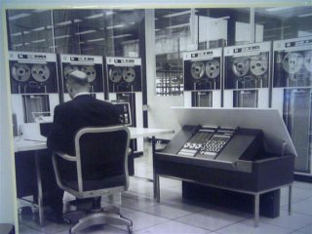
1999-2005 Worked on Enterprise server applications
Notes:
I worked for Microsoft Consulting Services as an enterprise consultant. During that time I ended up working on a lot of backend server systems. Instead of building web applications, I was focused on the services behind the scenes that might be called by web applications.
.NET Remoting, SharePoint, WCF, Enterprise Services, interop with Java, etc.
During this time, I also worked on a book on Application Interoperability between .NET and J2EE. That book spurred my interest in all the areas where the Microsoft stack can play nicely with others.

Slide 10
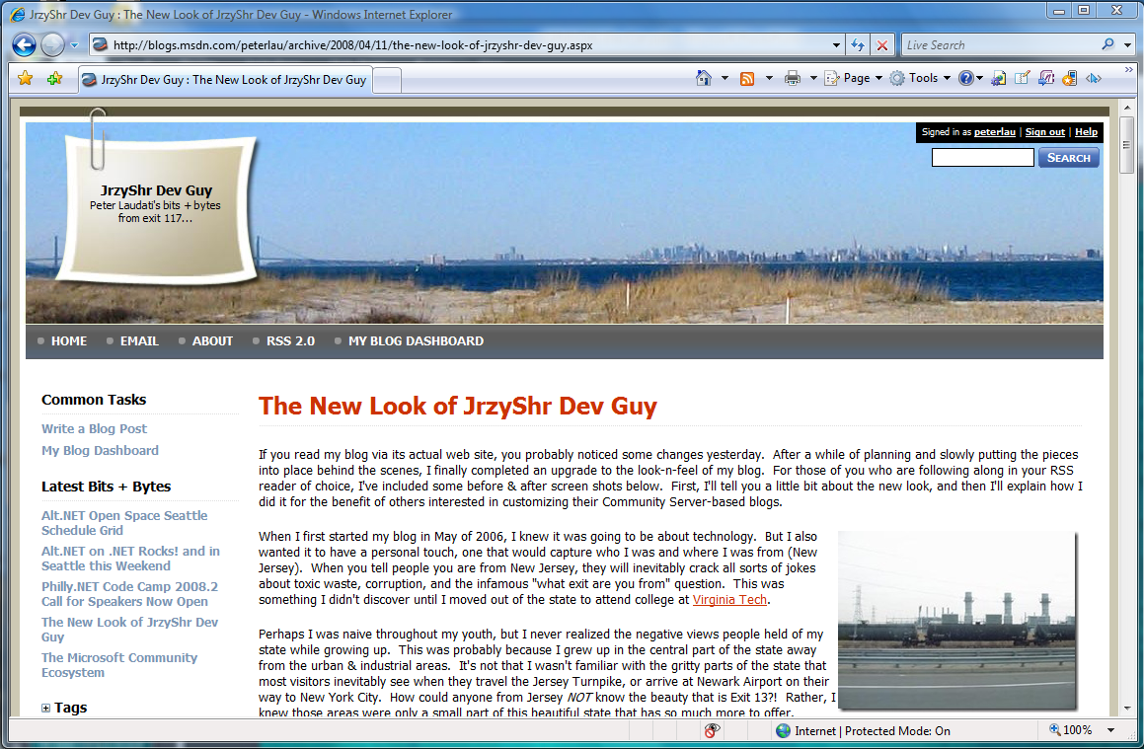
I blog, therefore, I am
http://www.peterlaudati.com
Notes:
Since 2005, I’ve been part of the Developer & Platform Evangelism organization at Microsoft.
I’m often asked, just what does a Developer Evangelist do? Well, I do a lot of things, but the thing you folks here may come to know me most for is that I write a blog called “JrzyShr Dev Guy”. That’s because I live near the Jersey Shore, not because of some Polish heritage (if you’re just reading “jrzyshr” and wondering what that stands for). I write about a lot of technology things, but the thing that might interest you most is that I write about developer events going on in our area.

Slide 11
So much time and so little to see!
So little time and so much to see!

Slide 12
My goals
Show some cool stuff
Tell you where you can get it
Tell you where you can learn more
Answer questions
Go have a beer with all of you

Slide 13
Stuff we’ll talk about
Microsoft & Open Source
PHP and IIS
SQL Server 2005 Driver for PHP
Microsoft AJAX Library
Silverlight
Expression Web 2.0
…

Slide 14
Open Source
Linux
Samba
Mozilla
Apache
MySQL
PHP
Ruby
Python
Java
Eclipse
Notes:
Linux:
Samba: MS joint testing and engineering with the Samba Team, Samba; announced that they’re satisfied with the agreement, and are taking a Work Group Server Protocol Program (WSPP) trade secret and copyright license. This will give them access to Microsoft specifications for the protocols in WSPP (such as file, print, and user and group administrative services) and allow the Samba Team to create, use, and distribute implementations; will significantly improve the process of Samba development, and produce better quality interoperation between Windows and Linux/UNIX environments.
http://port25.technet.com/archive/2007/12/19/If-you_2700_re-surprised_2C00_-you_2700_re-not-paying-attention.aspx
Mozilla: Vista compatibility testing, Windows media player plug in.
http://port25.technet.com/archive/2006/09/20/Why-I-invited-Mozilla.aspx
Apache: OSS lab engagement to improve Apache on Windows
http://port25.technet.com/archive/2008/02/26/the-apache-visit-to-microsoft-campus-day-one.aspx
MySQL: Visual Studio Industry Partner for .NET development with MySQL – 40% + of MySQL downloads are for Windows
http://www.mysql.com/windows/
PHP: Microsoft is working with Zend the PHP company and the PHP .NET community to make Windows and IIS great platforms for PHP applications; partners like Spikesource are certifying open source PHP applications on Windows
http://port25.technet.com/archive/2006/10/31/Zend-_2600_-Microsoft.aspx
Ruby: IronRuby, being built from the ground up as an open source project, MS-PL
http://www.iunknown.com/2007/07/a-first-look-at.html
Python: IronPython, available under MS-PL, being built as an open source project
http://port25.technet.com/archive/2007/04/30/python-java-ruby-oh-my-cross-platform-net-framework.aspx
Java: JBoss established an interoperability partnership with Microsoft including focus on the manageability of JBoss Enterprise Middleware System (JEMS) environments using Microsoft Operations Manager Operations Manager (MOM). Nearly half of JBOSS’ customer base is deployed on Windows.
http://www.microsoft.com/presspass/press/2005/sep05/09-27MSJBossInteropPR.mspx
Eclipse: making it easy for Java developers to write applications that look and feel like native Windows Vista enabling SWT to use Windows Presentation Foundation (WPF). We’re committing to improve this technology with direct support from our engineering teams and the Open Source Software Lab, with the goal of a first-class authoring experience for Java developers.
http://port25.technet.com/archive/2008/03/19/supernova.aspx

Slide 15
Microsoft Open Source Software & Novell Interop Labs
OSS Lab: Redmond, WA
Staffed by OSS and Linux experts
300 servers of varying types, Gumstix, Intel, AMD, Blades, HPC clusters, and IBM P6 series machines
Highest computing density of any Microsoft Redmond lab
Availability of over 340+ Linux Distributions
Testing interoperability OSS and Windows Technologies
Research on OSS technologies
Performance testing of Windows and OSS stacks
Novell Interop Lab: Cambridge, MA
2500 sq feet of lab and office space
Jointly staffed by Microsoft and Novell
80 servers running Intel Xeon dual and quad core technology and AMD Opteron dual core technology
Testing interoperability of virtualization, ws-management and identity federation solutions
SAMBA Interoperability testing
Notes:
The open source lab is really a great example of how Microsoft welcomes open source on the Microsoft platform. As you can see from the data on this slide – the highest computing density of any lab at Microsoft, 340+ Linux Distributions, 300+ server, etc – this is a significant investment.
Of the 140K+ projects on SourceForge today, over ½ of them run on Windows, and almost 30K are exclusively for Windows. So Windows has always been a pretty good platform for open source. The reason we are investing so much in the Open Source Software Lab is to ensure that Windows continues to improve as an excellent choice for open source software developers.
The main things that we do in this lab on a day to day basis is:
Verify interoperability
Learn about open source technologies
Make sure open source software runs great on Windows
The OSS lab gives us a physical place to work with open source software and Windows. Let’s talk a little bit about the types of software we look at…

Slide 16
OSS Lab Projects
Past:
Windows Media Player 11 interoperability
Silverlight Firefox compatibility
Silverlight /Moonlight implementation of common standard
SQL Server drivers providing connectivity from Java or PHP
Fast CGI hosting PHP and Python in IIS
Vista compatibility with Firefox
Present:
Hyper-V Linux Interoperability
Ws-man Compliance Tool System Mgmt interoperability
PHP Interop: PHP application connectivity to SQL Server
Apache Interop: ASF Technology Transfer
CardSpace relying party Java/PHP/Ruby/C Interop
HPC Linux/Windows environment Identity Integration, File Server Integration
Future:
PHP Active Directory Integration PHP/Sharepoint Integration
SugarCRM SQL Server Connectivity Collaboration
Continue providing technical support to Apache (Build Support)
Notes:
Build animation
Port25 or go to Firefox plug-in page (which redirects to Port25)
Relationships MS has been building with open source communities and vendors including daily, weekly, and/or monthly conf calls and meetings.
Here are a few good examples of recent projects that our OSS lab made possible.
Windows Media Player 11 on Firefox has been an absolute hit. Because of our investment earlier to build a relationship with the Firefox development team, we got word early on that they were having problems getting a media player to work with Firefox.
The OSS lab worked with the Windows Media Player development team and Microsoft legal to find a way to release an open source Windows Media Player plug-in for FireFox. This is real Microsoft IP being released into the Open Source community. This plug-in has been extremely popular – we’ve had over 2 million downloads of it already.
Moonlight is arguably a better example of Microsoft's commitment to open source. Moonlight is the name of the implementation of Silverlight for Linux; it runs on Mono. Sam gives a good overview of the project on Port 25 (http://port25.technet.com/archive/2007/09/05/silverlight-on-linux.aspx) and there are details to be read about here (http://tirania.org/blog/archive/2007/Jun-21.html). The whole effort only took about 21 days apparently - building Moonlight on top of the Mono runtime engine. Moonlight will be available for all the major Linux variations, and support Opera, Firefox and Konquerer.
Our SQL Server drivers for Java and PHP are ways of giving open source developers choices. They can use Java and/or PHP if they want to – but now they have an additional choice for a database, SQL Server.
Microsoft is shipping FastCGI and the native SQL Server Driver for PHP enables significantly improved performance and stability of PHP on Windows. We are collaborating with many high-profile open source PHP projects to include SQL Server compatibility in their application; for example we are working with Zend to improve the quality, stability and performance of PHP on Windows.

Slide 17
PHP and IIS

Slide 18
PHP on IIS – A Brief History
First, there was CGI
Invokes new process for each request
Easy to configure, pretty stable
SLOOOW due to overhead of process creation
Then, ISAPI extension
Loaded in process
Better performance
Not stable if code isn’t thread safe
What’s the solution?

Slide 19
The solution - FastCGI
Extension to CGI that allows reuse of a process
Easy to Configure
Faster than CGI
More stable than PHP on ISAPI
Able to leap tall buildings in a single bound
Can run non-thread-safe versions of PHP

Slide 20
More on FastCGI
Developed in close collaboration with Zend Technologies
Improvements in PHP engine for IIS with contributions and collaboration back to PHP Community
Zend Core Available for Commercially Supported PHP
Available for IIS6 (Windows Server 2003) or IIS7 (Windows Vista SP1 or Windows Server 2008)
Fully supported by Microsoft
Where do I get it? http://www.iis.net/php

Slide 21
IIS7 Cool New Features
Modular architecture
XML configuration
Remote management
Advanced diagnostics
Integration with Windows Media Server
Can easily extend with managed code

Slide 22



New Modular Architecture The integrated pipeline
Native
Managed
Managed
Custom
- or -
ASP.NET
Static
Compress
Cache
Logging
Anon
Basic
FastCGI
ASP
Errors
ISAPI
Tracing
Forms
UrlAuth

Slide 23
Demo

Slide 24
Leverage the Platform
Rich functionality in IIS7
Included modules such as Membership
Add-on modules from http://IIS.net
SQL Server 2005 Driver for PHP
Other Windows Applications
Active Directory
Exchange
SharePoint
Office

Slide 25
Add-On Modules
Publishing
WebDAV - Released
FTP7 - Released
Frontpage Server Extensions - Released
Media Pack
BitRate Throttling – Go Live
Playlists - CTP
Other modules to come…

Slide 26
Good IIS and PHP resources
IIS Authentication plugin for the Wordpress PHP blogging engine
http://tinyurl.com/ytwndt
Installing PHP apps on IIS7
http://channel9.msdn.com/Showpost.aspx?postid=356242

Slide 27
SQL Server 2005 driver for PHP

Slide 28
SQL Server 2005 Driver for PHP
Goal: Provide robust, scalable, and reliable SQL Server connectivity for PHP developers targeting the Windows platform
Enterprise “abilities” to PHP/SQL Server Devs.
Reliability
Scalability
Maintainability
Base the PHP driver's API on existing data patterns
API changes made based on community feedback during beta
For more info, see the team blog http://blogs.msdn.com/sqlphp
Version 1.0 Released July 2008!

Slide 29
Demo

Slide 30
ASP.NET AJAX and PHP

Slide 31
What is AJAX?
Asynchronous JavaScript And XML
Client/server communication without loading a new page

Slide 32
What else does AJAX sometimes mean?
DHTML: HTML + JavaScript behavior
Animations
Drag/drop
Show/hide details
Partial page updates
Replace part of the page with UI from the server
Stock ticker, news headlines
Often with a timer
AJA*: XML, HTML, text, JSON

Slide 33
What is ASP.NET AJAX?
Microsoft AJAX Library
Cross-browser, cross-platform, cross-backend
Pure JavaScript
ASP.NET AJAX Extensions
ASP.NET-only server controls
AJAX Control Toolkit
Shared-source, community project, built on AJAX Extensions

Slide 34

Microsoft AJAX Library
Client
XHTML/CSS
Server-generated
Proxy Scripts
Microsoft AJAX Library
Components
Browser Compatibility
Networking
Core Services
Browsers (IE, Firefox, Safari, others)

Slide 35
AJAX Library Design Goals
Framework for OOP in JavaScript
Namespaces, properties, events, inheritance, reflection, …
Encapsulation of controls/behaviors
Reusable script components, easy to associate with HTML elements
Cross-browser abstraction
IE, Firefox, Safari, Opera
Seamless integration with “web services”

Slide 36
Demo

Slide 37
Complex Object Support
public class Customer {
public string FirstName {
get {} set {}
}
public string LastName {
get {} set {}
}
}
public class CustomerService : System.Web.Services.WebService {
[WebMethod]
public Customer GetCustomer(int id) {
return new Customer(“bill, “gates”);
}
[WebMethod]
public void UpdateCustomer(Customer customer) {
// todo: update database
}
}

Slide 38
Complex Object Support
<script language=“JavaScript”>
function getCustomerInfo() {
CustomerService.GetCustomer(123, onCustomerComplete, onTimeout);
}
function onCustomerComplete(results) {
firstNameTxt.value = results.FirstName;
lastNameTxt.value = results.LastName;
}
function updateCustomerInfo() {
var customer = new Customer();
customer.FirstName = “Bob”;
customer.LastName = “Jones”;
CustomerService.UpdateCustomer(customer, onUpdate, onTimeout);
}
</script>

Slide 39
Microsoft AJAX Library
Downloads, documentation, etc.
http://ajax.asp.net
PHP for Microsoft AJAX Library
http://codeplex.com/phpmsajax
Steve Marx’s webcast
http://tinyurl.com/2pwd5z

Slide 40
Silverlight

Slide 41

Microsoft Silverlight
is a
cross-browser, cross-platform,
cross-device plug-in
for delivering
the next generation of
.NET-based
media experiences
&
rich interactive applications (RIAs)
for the Web

Slide 42
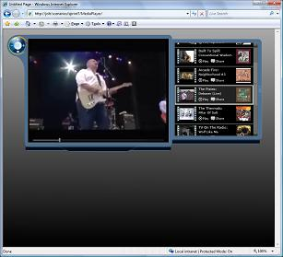
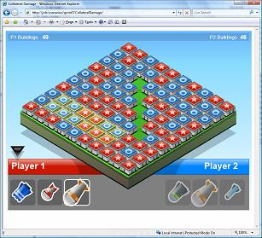
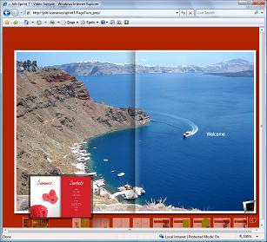
Silverlight Overview
Compelling Cross-Platform User Experiences
Immersive media experiences & RIA
Seamless, fast installation for end users
Consistent experiences on Mac / Windows
Flexible programming model with collaborative tools
Integration with Web technologies
Based on the .NET Framework
Role specific tools for designers / developers
Efficient, lower cost delivery, and more capable media
HD to Mobile w/ SMPTE VC-1
Broad media ecosystem
Tools for live and on-demand publishing

Slide 43

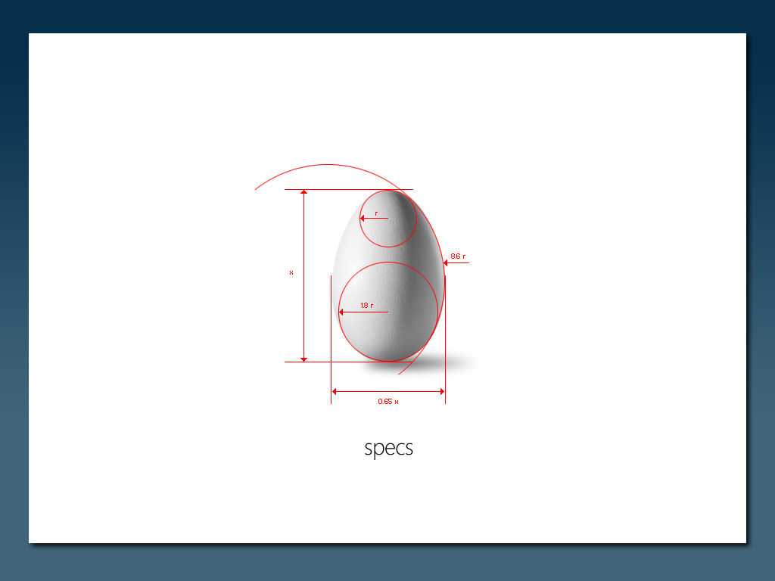
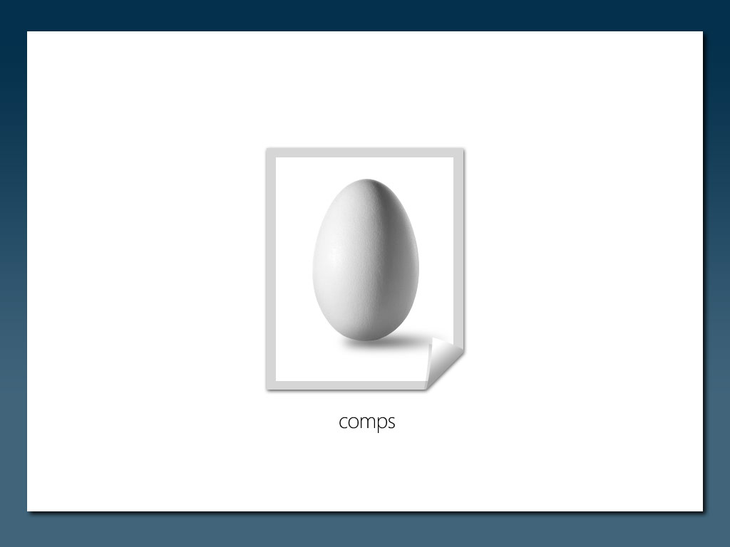

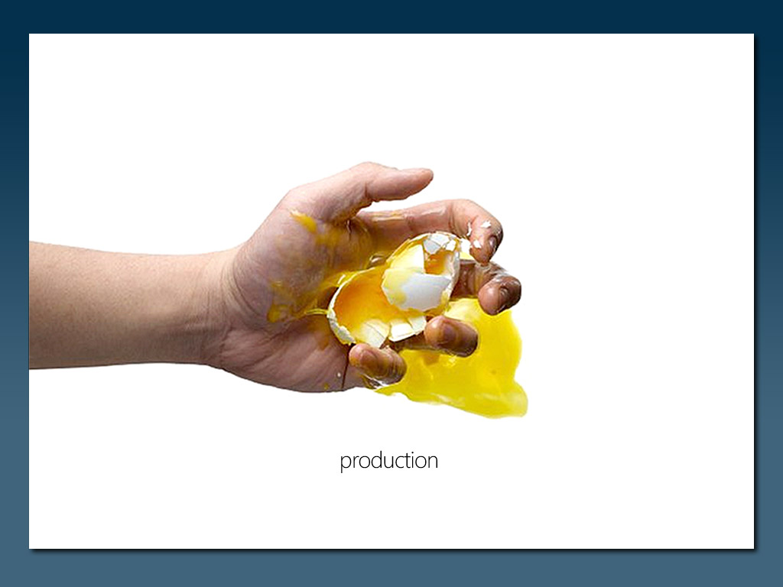
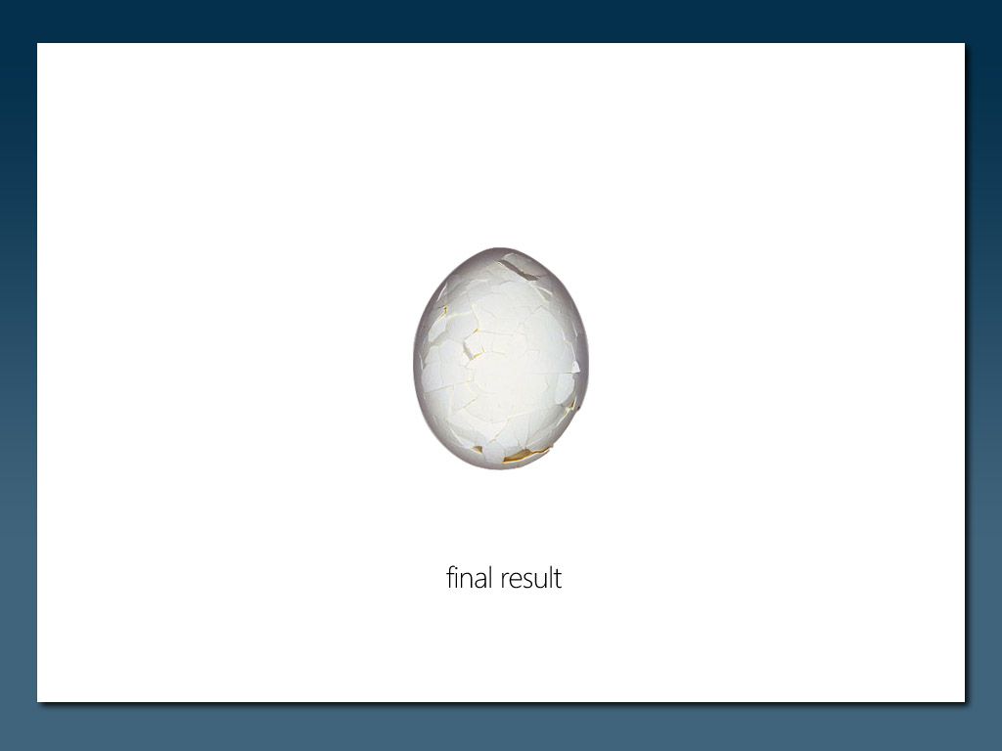
Designer/Developer Collaboration
=

Slide 44
Key technology aspects
Silverlight asset delivered as text-based XAML
XAML can come from static file or dynamic server code
XAML defines UI and animations
XAML events can be raised to code
XAML can be changed at “runtime”
.

Slide 45
Silverlight Development Model
JavaScript AJAX
Supported with Silverlight 1.0 and 2
Enables JavaScript to program both HTML and JavaScript together
Fully supported with ASP.NET AJAX
.NET
Supported with Silverlight 2
Cross platform version of the .NET Framework included with Silverlight
Fully supports VB and C# development in the browser
Supports dynamic languages (IronRuby, IronPython, etc)

Slide 46
Silverlight 2 Runtime Features
2D, Graphics
Audio, Video
Animations
Text, Text Input*
Controls*
Layout*
Styles/Templates*
Data Binding*
Networking
HTTP/S and Sockets*
.NET Support*
C# and VB.NET*
LINQ*
XML APIs*
Generics*
HTML Integration*
JSON Serializer
Local storage*
Crypto APIs (AES)*
Threading*
* New in Silverlight 2

Slide 47
Demo

Slide 48
Get Started!
Visit Silverlight site for samples, demos, videos, whitepapers http://www.silverlight.net
Install the Beta 1 Runtime
http://www.microsoft.com/silverlight/resources/installationFiles.aspx?v=2.0
Install the Visual Studio 2008 tools
http://www.microsoft.com/downloads/details.aspx?FamilyId=E0BAE58E-9C0B-4090-A1DB-F134D9F095FD&displaylang=en
Install the Silverlight 2 Beta 1 SDK
http://www.microsoft.com/downloads/details.aspx?FamilyId=4E03409A-77F3-413F-B108-1243C243C4FE&displaylang=en
Expression Studio beta
http://www.microsoft.com/expression/products/download.aspx?key=studio2beta

Slide 49
General resources
MIX 08 sessions
http://sessions.visitmix.com
Channel 9
http://channel9.msdn.com
PHP on IIS
http://www.iis.net/php

Slide 50

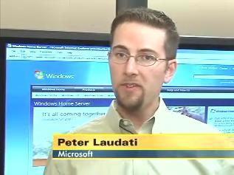
Questions?
Peter Laudati
Developer Evangelist, Microsoft
http://www.peterlaudati.com

